Slide 1
Murfreesboro Soccer Club
Recreational Coaches Meeting
Spring 2018
Notes:
Yochum – Welcome and get started

Slide 2
Office Location
Murfreesboro Soccer Club
2690 Memorial Blvd Ste. C #4
Murfreesboro TN 37129
Office Telephone Number: 615-203-6603
Email Address: admin@murfreesborosoccer.com
Office Hours: M-Th 10am-2pm
Rec Saturdays: 9am-12pm (meeting room at soccer park)
Notes:
Yochum

Slide 3
Club Mission Statement and Philosophy
“Uniting our community by creating a passion for soccer.”
Enjoyment of the Game
Our club endeavors to present techniques, tactics, training and game environments in such a manner which promotes all players’ enjoyment of soccer. Our goal is developing a life-long love of the game, regardless of the eventual level of play a player attains.
Notes:
Yochum

Slide 4
Club Representatives
President-Bryan Kleparek
DOC-Ali Arman
DOB – Mike Cowles
Rec Chairman-Brian Yochum
Rec Commissioners:
U5 - Clint Teasley clintt@murfreesborosoccer.com
U6 - Ralph Krishler ralphk@murfreesborosoccer.com
U7 – Jason Kirouac jasonk@murfreesborosoccer.com
U8 – Tony Tarway mcanthonyt@murfreesborosoccer.com
U10 – Jason LaForte jasonl@murfreesborosoccer.com
U12 – Kathelene Young katheleney@murfreesborosoccer.com
U14 – Nick Odette nicko@murfreesborosoccer.com
U19 - Dennis Buckley dennisb@murfreesborosoccer.com
Notes:
Yochum – Introductions
Kleparek – Words from the pres.
Arman – Words from the DOC
Commish Intros

Slide 5
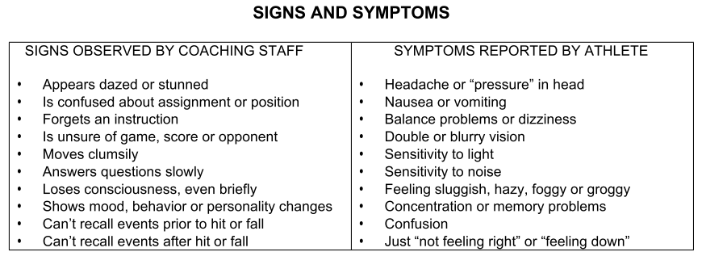
Risk Management
Concussions
Policy:
Annual completion of a head injury safety education course by all staff and coaches (document part of registration process – will be emailed to all coaches after meetings, please review)
Any youth player who shows signs, symptoms and behaviors shall be removed from play and evaluated using the symptoms checklist
No youth athlete who has been removed from play for a suspected concussion shall return without written clearance from a licensed health care provider (MSC must receive a copy of the return to play form)
Signs and symptoms:
Notes:
Yochum

Slide 6
Risk Management
Sudden Cardiac Arrest (SCA)
Policy:
Annual completion of a sudden cardiac arrest education course by all staff and coaches (document part of registration process – will be emailed to all coaches after meetings, please review)
Any youth player who passes out or faints while participating in an athletic activity or exhibits listed symptoms will be immediately removed from the activity
No youth athlete who has been removed from play for symptoms consistent with SCA shall return without written clearance from a licensed health care provider (MSC must receive a copy of the return to play form)
Symptoms:
Fainting or seizures during exercise
Unexplained shortness of breath
Chest pains
Dizziness
Racing heart rate
Extreme Fatigue
Notes:
Yochum

Slide 7
Risk Management
Abuse Awareness Act
Policy is forthcoming, here are initial details:
Act has passed both houses of congress and waiting to be signed by the President
Code of Conduct:
Immediately must start reporting – 24 hrs to report
Reporting tool will be made available in the future
Zero Tolerance & reports will be directed to appropriate agency
If a coach or volunteer has cause to believe a child’s physical or mental health/welfare has or may be affected by abuse or neglect it must be reported League Officials, State Association’s Risk Mgmt Chair or Designated Soccer Association Rep.
Coaches and Volunteers – No Intoxicants
Coaches and Volunteers – Can not use or possess tobacco products in presence of minor athletes or their parents
Should never be nude in presence of minor athletes
Notes:
Yochum

Slide 8
Risk Management
Abuse Awareness Act (cont.)
Code of Conduct (cont.):
No sexually oriented conversations – about dating, own personal relationships, etc.
Be very aware of what is appropriate physical contact with a player
Physical contact must take place in public, have no potential for physical or sexual intimacies during contact, and must be for the benefit of the player, not to meet emotional need of adult
What is inappropriate:
Asking player to sit in your lap, a lingering hug, slapping, hitting, punching, kicking to discipline, cuddling, playful contact not part of training (horseplay, butt-pats, tickling or wrestling)
And, any other contact that is deemed inappropriate
Bullying, Harassment, Hazing
Hitting, pushing, punching, beating, biting, striking, kicking, choking
Throwing at or hitting another with objects, including equipment
Coercing or forcing another to do something in order to join the group
No Tolerance and it is a violation of the Code of Conduct if a coach, volunteer or player knows of misconduct but takes no action to intervene
Notes:
Yochum

Slide 9
Risk Management
Abuse Awareness Act (cont.)
Code of Conduct (cont.):
Peer to Peer Sexual Abuse – approximately 1/3 of all reported sexual abuse occurs at the hands of other children. Be aware and report. High risk:
Locations not easily seen
When unclothed or changing clothes
Social Media and Communication with players:
All communication readily available to share with parents
All must be public and in groups with everyone included… No private message…Purpose of communication must be about team activity or team purpose
Coaches cannot “re-tweet” athlete posts and cannot direct message
Email and texting is ok directly to player if over 14, but must copy parent or guardian, assistant coaches and be between 7am and 10pm
Use of Snapchat and other similar apps is not permitted with players
Notes:
Yochum

Slide 10
Risk Management
Inclement Weather
Guidelines:
MSC staff will monitor and communicate on Saturday game days
MSC will communicate via the RainOut alert system, through Referees and Staff.
However, coaches must follow these guidelines at other times during the week:
At first sight of lightning, all fields must be cleared
Must exit to vehicles or Must be inside bathrooms at the pavilions
It is not acceptable to be under the covering
Must wait 30 minutes before returning to play
If additional lightning is observed, restart 30 minute timer from the last strike
If delayed for more than 45 minutes cancel activity and reschedule if necessary.
Notes:
Yochum

Slide 11
Risk Management
Emergency procedures
Practice sessions:
Evaluate the situation
Call 911 if the situation is life threatening
Speak with parents
Contact commissioner ASAP
Game days:
Assess the situation
Call 911 if situation is life threatening
Speak with ref to contact assignor
Look for MSC Staff in general areas or on golf carts
Notes:
Yochum

Slide 12
Recreational Technical Director
MSC Recreational Technical Director:
Matt Manning - mattm@murfreesborosoccer.com
Primary focus for our Rec Technical Director:
First point of contact for rec coaches on soccer related matters; curriculum, help with running a session, program questions, etc.
Create, update and implement curriculum for U5-U19 age groups
Work with all coaches within each age group to provide guidance and support where appropriate
Oversee the weekly U5-U8 practices
Notes:
Yochum – Introduce Matt
Manning – Cover role

Slide 13
Recreational Coaches Clinic
Murfreesboro Soccer Club Coaching Clinic
Tennessee State Soccer Association
Partnered with a group called the Creative Coaching Academy
Will be awarded with a Creative Coaching Diploma when completing the course.
Course is 100% FREE!
When: March 10,, 3-6pm
Where: MTSU Health and Wellness Center’s Indoor Soccer Field
https://tnsoccer.box.com/s/hr60il8isvnjpz89h0f3aebgjp54cent
Notes:
Manning

Slide 14
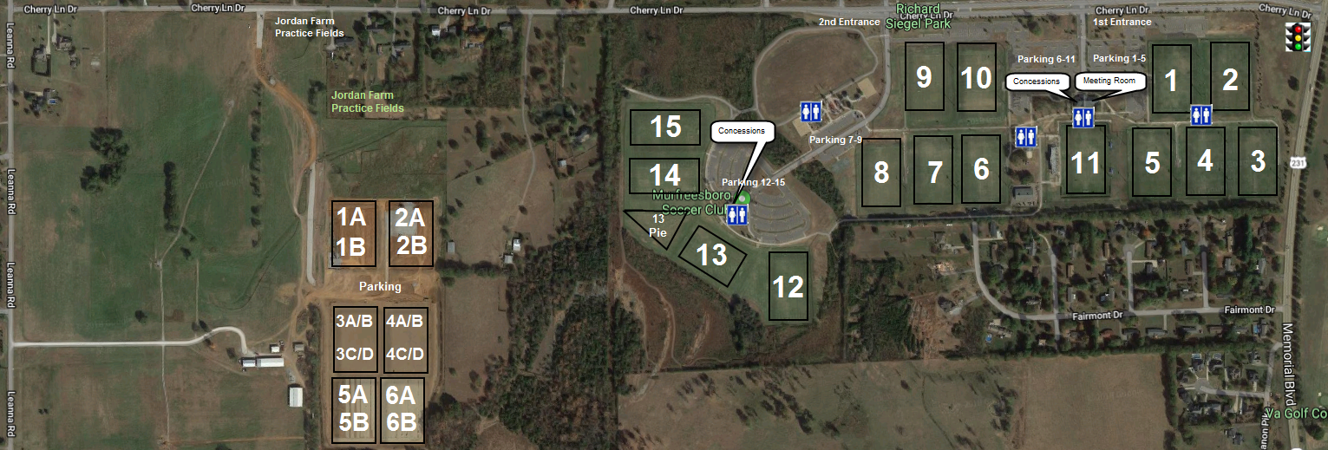
Field Locations
Cherry Lane Facilities
Notes:
Manning

Slide 15
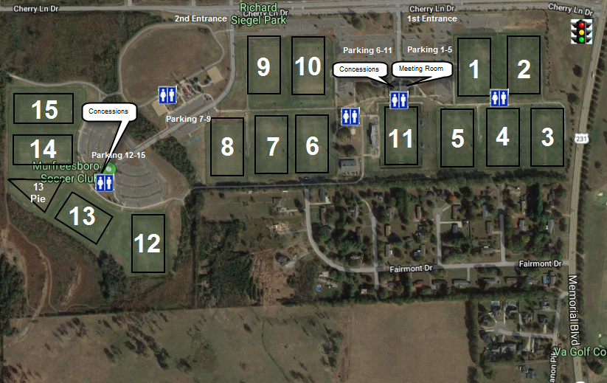
Field Locations (cont.)
Richard Siegel Soccer Park (RSSP)
Notes:
Manning

Slide 16
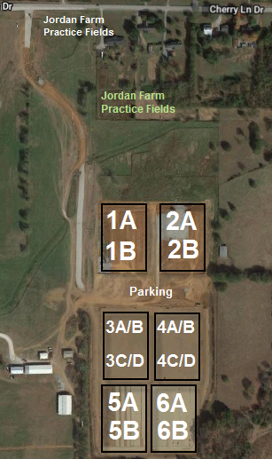
Field Locations (cont.)
Jordan Farm Practice Fields
Notes:
Manning

Slide 17
Recreational Program
The program puts an emphasis on five principles:
1. Having Fun!
2. Everyone Plays at least 50% of games
3. Balanced Teams
4. Positive Coaching and Sportsmanship
5. Player Development (Small-Sided Games)
Notes:
Manning

Slide 18
Coach Responsibilities
Communication with parents, players immediately following meeting.
Notify your commissioner immediately if a player on your team decides not to play.
Communicate with players/parents throughout season.
Attend all practices and games.
Follow the club’s curriculum which has been designed to follow the players age appropriate needs.
Remind players to keep uniforms (in the Fall season only).
Coaches Card and Background Checks
Please note:
The Club does not provide trophies for age groups U6-U19.
Club does provide medals for all age groups at the Jamboree.
Notes:
Manning

Slide 19
Recreational Coach Guidelines
Please refer to the handout
Notes:
Manning

Slide 20
Heading Restrictions
As part of the United States Soccer Federation (USSF) Concussion Initiative, Tennessee State Soccer Association (TSSA) will be prohibiting players age 10 and younger from heading the ball in practice and games. The intent of the initiative and the new rules that TSSA will be implementing is for safety of the player.
Notes:
Manning

Slide 21
Do Not Forget Tonight
Your team name and number
Practice location and time
Team roster
Your commissioner’s information
Uniform collection at RSSP meeting room
Pick up times will be sent to coaches when available
Policy for coaches – must have disclosure completed for background checks to receive uniforms
Policy for players – Uniforms will be withheld for players that are not current on their account
Notes:
Manning

Slide 22
Age Group Specific Information

Slide 23
U5-U6 Practices
U5-U6 practices will be overseen by Coach Smith and MSC Select Staff. Team coaches should be attending and participating.
The first 2-3 sessions will be led by the MSC staff with coach assistance. This allows our coaches to see how the practice sessions will run
The remaining sessions will be led by the parent coaches with assistance from the staff coaches to help the parent coaches
Each practice session will follow a dedicated age appropriate practice plan developed by MSC.
Practice times for these age groups will be as follows:
Age Group Days Times
U5 Monday 5.00-6.00 or 6.00-7.00
U6 Tuesday (or) 5.00-6.00
U6 Thursday 6.00-7.00
*Practices will be held on Field 5 at RSSP
Notes:
Clint, Smith or Manning???

Slide 24
U5-U6 Games
U5 games will be led by the parent coaches with assistance from the staff coaches. MSC Staff will facilitate and direct the overall game flow each Saturday
U5 will play 3 round robin games each Saturday. One team will be the Home team and stay on the same field. The Away team will rotate for each game. The format will be a 10 min warm-up followed by 3, +/- 12 minute games
U6 games will be led by the parent coaches and will play a single game per scheduled time. We will have Coach Mike or staff coaches floating to observe, provide suggestions or answer questions
Game objectives for U5 and U6:
Coach, encourage and recognize the skills that were used in the Monday practice
All restarts will be from the coaches, rolling (not tossing) a ball back into play from the general area the ball left play
There are no kick-offs, goal kicks, corner kicks, throw-ins, free kicks or penalty kicks
There are no goalies
There are no referees
Notes:
Clint, Smith or Manning???

Slide 25
U7 Practices
U7 practices will be overseen by Coach Smith and MSC Select Staff. Team coaches should be attending and participating.
The first 2-3 practice sessions will be led by the MSC staff with coach assistance. This allows new coaches to see how the practice sessions will run that have not been through our U5 or U6 Academy
The remaining sessions will be led by the parent coaches with assistance from the staff coaches to help the parent coaches
Each practice session will follow a dedicated age appropriate practice plan developed by MSC.
Practice times for these age groups will be as follows:
Age Group Days Times
U7 Tuesday (or) 6.00-7.00
U7 Thursday 5.00-6.00
*Practices will be held on Field 5 at RSSP
Notes:
Jason, Smith or Manning???

Slide 26
U7 Games
U7 games will be led by the parent coaches and will play a single game per scheduled time. We will have Coach Mike, Staff Coaches or Commissioners floating to observe, provide suggestions or answer questions
Game objectives for U7:
Coach, encourage and recognize the skills that were used in the Tues/Thurs practices
All restarts are per FIFA rules (throw-ins, goal kicks, corner kicks, etc.)
On goal kicks, opposing players must start behind the build out line
There are no goalies
There are referees and coaches should be coaching from the sideline
Note: These are young referees and are generally someone’s middle or high school aged son or daughter. Please be respectful and treat them as you would want someone to treat your own child
Notes:
Jason, Smith or Manning???

Slide 27
U8 Practices
This spring season all U8 teams will practice two days a week with optional Tech Session
Tuesdays 5-6:15pm for boys teams, and 6:15-7:30pm for girls teams
Thursdays 5-6:15pm for girls teams, and 6:15-7:30 for boys teams
All practices will be on Field 4
Tuesday’s practice will be held by MSC 8U Academy Director Erich Delfs, MSC coaches and Staff coaches
Team volunteer coaches need to attend as well
Thursday’s practices will be led by team volunteer coaches
MSC 8U Academy Director and MSC coaches will be there to assist volunteer coaches
Optional Technical Session for players on Friday nights with Coach Fifi There will be a session for the boys and a session for the girls. Times are TBD
The Rec TD will provide age appropriate curriculum for volunteer coaches to follow during Thursday practice
U8 practices will start next Tuesday, March 6th
Notes:
Tony, Delfs or Manning

Slide 28
U8 Games
U8 games will be led by the parent coaches.
Game Objectives for U8
Games will be small sided 4v4 format.
Games will be played in four, 12min quarters with a 5 min halftime.
No Goalkeepers
No Offside
All restarts are per FIFA rules (throw-ins, goal kicks, corner kicks, etc.)
On goal kicks, the defending team will start at midfield as the play out line.
There are referees and coaches should be coaching from the sideline
Note: These are young referees and are generally someone’s middle or high school aged son or daughter. Please be respectful and treat them as you would want someone to treat your own child
Notes:
Tony, Delfs or Manning

Slide 29
U10
U10 games will be led by the parent coaches.
Games will be 7v7 including keepers
Recommended formation is 1-2-3-1
Playout line will be used for all restarts
Offsides will be standard rules (not the playout line)
No player should play more that 50% of game time in the same position
Coaches should be coaching from the sideline, be respectful of the referees and ensure their parents are too
Note: These can be younger referees and are generally someone’s middle or high school aged son or daughter. Please be respectful and treat them as you would want someone to treat your own child
Notes:
Jason or Manning???

Slide 30
Play Out Line Example
Red can be inside the play out line
Blue team is behind the play out line
Notes:
Manning

Slide 31
U12, U14-Coed & U19-Coed
With the lower numbers at the U14 age group, we will continue this group as a coed division again this season. The Club closely monitored games and discussions with players, parents and coaches were positive.
U19 will play 9v9 this season as an opportunity to allow players to get more touches and move to 6 teams
Games will be 9v9 including keepers
Recommended formation is 1-3-4-1
No heading for U12
No player should play more that 50% of game time in the same position
Coaches should be coaching from the sideline, be respectful of the referees and ensure their parents are too
Note: These can be younger referees and are generally someone’s middle or high school aged son or daughter. Please be respectful and treat them as you would want someone to treat your own child
Notes:
Morrison or Manning???

Slide 32
U14 and U19
We have an opportunity to schedule inter-club games for a team from both divisions.
A Saturday near the end of the season, we may host a few teams from Nolensville Soccer Club.
This is an opportunity for the older age groups with limited numbers of teams to get exposure to additional teams and build inter-club relationships.
Notes:
Yochum

Slide 33
Technical Sessions U10-U19
Rec Technical Sessions offered this Spring for the older age groups
U10 & U12 on Friday, 5:30-6:30pm on Field TBD
U14 & U19 on Friday, 6:30-7:30pm on Field TBD
This is an opportunity for older players who want an extra practice, middle/HS players looking for additional technical coaching, or for parents that just need to get the tweens/teens off the devices
Technical Director Matt Manning will be leading these sessions each week
Notes:
Manning

Slide 34
Important Dates
2/28 Start Contacting Players
3/3 MSC Shop Day at Dick’s Sporting Goods
3/5 First Week of Practice
3/10 Coaches Education With CCA @ MTSU
3/17 First U5-U14 Recreational League Games
3/19 First U19 Games
3/31-4/1 2nd Weekend of Spring Break – No Games
4/6-4/8 Bash In The Boro Tournament – No Games
4/14 Photo Day #1 U5-U8
4/28 Photo Day #2 U10-U14
5/12 Last Regular Scheduled Games
5/19 Jamboree/Season End Celebration
Rain makeup will become double-header 5/12
Notes:
Manning

Slide 35
Questions?

